Slide 1
OSCE-II
CVS

Slide 2
CHD
Acyanotic Congenital Heart Lesions
  Lesions Resulting in Increased Volume Load
    Eg. ASD, VSD, PDA, AV-canal defect (increased pul. vascularity)
  Lesions Resulting in Increased Pressure Load
    Pulmonary stenosis, aortic stenosis, coarctatition of aorta (normal pulmonary vascularity)
Cyanotic Congenital Heart Lesions
  Cyanotic Lesions with Decreased Pulmonary Blood Flow
    e.g. tricuspid atresia, TOF, single ventricle with pulmonary stenosis, pulmonary atresia
  Cyanotic Lesions with Increased Pulmonary Blood Flow
    e.g. TGA, TAPVR, truncus arteriosus.

Slide 3
Cont’d
DX
1. cyanotic or acyanotic
2. CXR
3. ECG/ Echo
Hyperoxia test
  Adminstration of 100% O2 improves cyanosis= resp. problem
  If not cardiac
Principle of mx
  Correct the underlying defect
  Rx of CHF
  Prevention and treatment of complication
Notes:
Complications: PHtn, IE, policytemia, throboembolism

Slide 4
VSD
VSD
Indications for surgical closure of a VSD include:
  Patients at any age with large defects in whom clinical symptoms and FTT cannot be controlled medically;
  Infants b/n “6 and 12 mo” of age with large defects associated with pulmonary Htn.
  Patients >24 month of age with a Qp : Qs ratio greater than 2 : 1.
  Patients with a supracristal VSD of any size.
NB. Severe PVD nonresponsive to pulmonary vasodilators is a contraindication to closure of a VSD.
Complications
Infective endocarditis
Recurrent lung infection
Heart failure
Pulmonary HTN
Acquired pulmonary stenosis
Aortic valve regurgitation

Slide 5
ASD
AVSD

Slide 6
PDA
May associate with maternal rubella
c/f
  bounding peripheral arterial pulses and a wide pulse pressure
  continuous murmur
  Heart failure
PDA is Seen often in Preterm infants and spontaneous closure occurs in most instances
Spontaneous closure of the ductus after infancy is extremely rare.

Slide 7
Cont’d
Complications
  Infective Endocarditis/Endarteritis
  CHF
  Embolization
  Pulmonary HTN
IX
  CXR-normal if PDA is small
  CXR- in large PDA, enlargement of the LA, LV, and PA, and an increase in pulmonary vascular markings .
  ECHO- diagnostic
mx:
  Irrespective of age, patients with PDA require surgical or catheter closure.

Slide 8
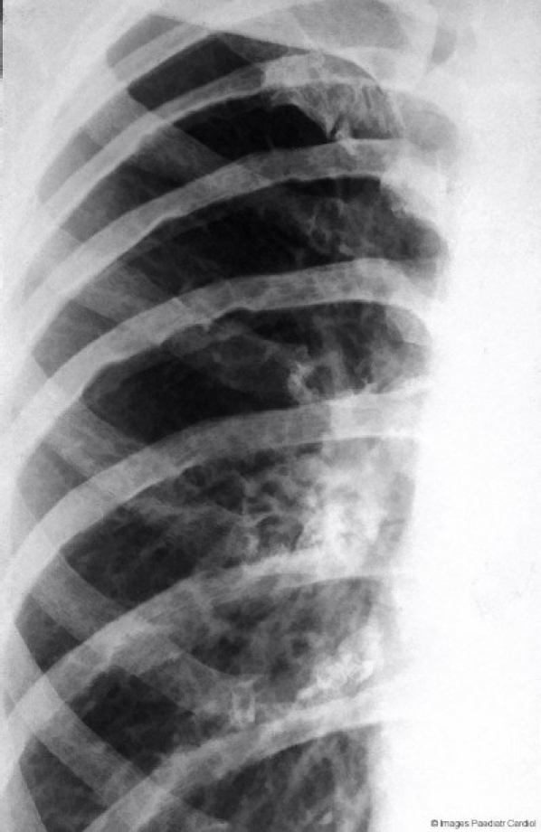
COA
CXR:
  cardiomegally
  Pulmonary congestion
  Notching of the infe. Border of the ribs
MX
  prostaglandin E1,
  surgery
Notes:
Infant form is common and associate with turner syndrome

Slide 9
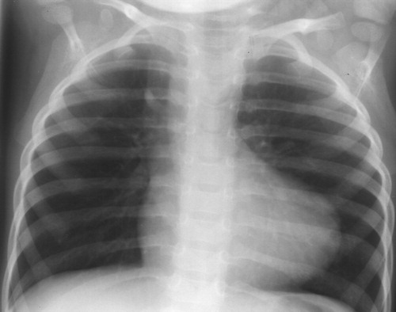
TOF
CXR
Boot or wooden shoe shaped heart
Diminished pulm. BF

Slide 10
Cont’d
Paroxysmal hypercyanotic attacks (hypoxic, “blue,” or “tet” spells).
C/f:
  Increased cyanosis, agitaion, fast and deep breathing, syncope
  Usually in the morning with initial awakening or after vigorous cry
Mx:
1. fluid resuscitation
2. place the infant in knee chest position
3. adminster O2
4. morphine (0.2mg/kg sc)
5. if acidotic; sodium bicarbonate

Slide 11
Cont’d
Complications:
  polycythemia
  Cerebral thromboses
  Brain abscess
  Bacterial endocarditis
Associated anomalies:
  PDA
  Right aortic arch
  DiGeorge syndrome
Treatment:
  Prevent dehydration/polycythemia
  surgery

Slide 12
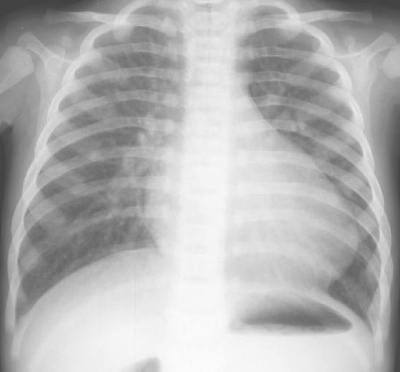
TGA
CXR- cardiomegally, a narrow mediastinum (“egg-shaped heart”), increased pulmonary blood flow.
ECHO- is diagnostic
Treatment:
  prostaglandin E1
  Rashkind balloon atrial septostomy
  Surgery- arterial switch (Jatene) procedure
Notes:
D transposition- Survival in immediate newborn id provided by PFO, PDA, ASD

Slide 13
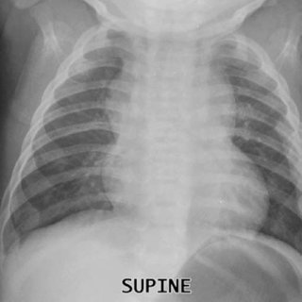
TAPVR
CXR: snowman appearance
Mx:
surgical repair

Slide 14
ARF
Modified Jones Criteria:
Major criteria :
  Carditis
  Arthritis/polyarthralgia
  Sydenham’s chorea
  Erythema marginatum
  Subcutaneous nodules
Minor criteria :
Clinical findings
  Arthralgia- monoarthralgia vs polyarthralgia
  Fever- 380C vs 38.50C
Laboratory findings
  Elevated acute phase reactants (ESR- 30 vs 60, CRP).
  Prolonged PR interval.

Slide 15
Cont’d
Supporting evidence for antecedent streptococcal pharyngitis:
  Positive throat culture or rapid streptococcal antigen test.
  Elevated or rising streptococcal antibody titer.
      antistreptolysin O (80-85%)
      95-100% patients have an elevation either of the following -antistreptolysin O, anti-DNase B, antihyaluronidase
Diagnosis made with:
2 major criteria or 1 major and 2 minor criteria
plus
Supporting evidence for antecedent
streptococcal pharyngitis (mandatory).

Slide 16
Cont’d
Exceptions (strict adherence to Jones criteria not needed):
  1. Sydenham’s Chorea
  2. Indolent Carditis
  3. Rheumatic Fever recurrence

Slide 17
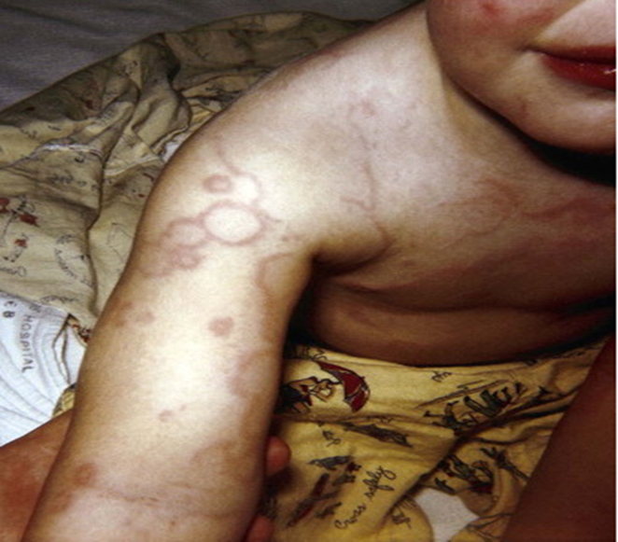
Cont’d
Erythema marginatum
Evanescent, erythematous, macular nonpruritic rash with pale centers and rounded or serpinginous margins.
Mostly trunk and proximal extremities.
accentuated by warming the skin.

Slide 18
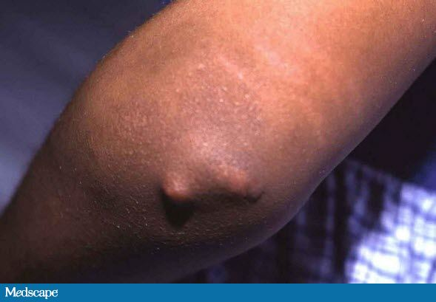
Cont’d
Subcutaneous nodules
Firm, painless, freely movable nodules approximately 1cm size in diameter.
Most often seen in patients with carditis.
Usually located over the extensor surfaces of the joints (elbows, knees and wrists), in the occipital portion of the scalp, or over the spinous processes.

Slide 19
Cont’d
DDX
  Rheumatoid arthritis
  Reactive arthritis
  Malignancy
  SLE
  Viral/bacterial myocarditis/pericarditis
MX
General
  Place on bed rest and monitor closely for evidence of carditis.
  Antibiotic treatment for 10 days with oral penicillin or erythromycin or a single IM dose of Benz. Penicillin.
  Long-term antibiotic prophylaxis.

Slide 20
Cont’d
Anti – inflammatory therapy:
  Withheld anti-inflammatory treatment till full blown picture of RF appears.
Pain relief – achieved by acetaminophen.
Migratory polyarthritis and carditis with out Cardiomegaly or CHF
→ ASA 50-70mg/kg/24hr divided into 4 doses po for 3 – 5 days,
then 50mg/kg/24hr for 3weeks and half that dose for 2-4week.
Carditis with cardiomegaly or CHF
→ Prednisone 2mg/kg/24hr divided into 4 doses po for 2 – 3weeks
followed by half the dose for 2-3weeks then taper. While tapering prednisone start ASA 50mg/kg/24hr in 4 divided doses for 6weeks.
Supportive treatment
moderate to severe carditis -digoxin, fluid and salt restriction, diuretics, and oxygen.

Slide 21
Cont’d
Mx: Chorea
  anti-inflammatory agents are usually not indicated.
  Sedatives -phenobarbital or haloperidol or chlorpromazine

Slide 22
Cont’d
I. Primary Prevention (prompt and proper treatment of GAS pharyngitis) with in 9 day of symptom.
a) Benz. Penicillin
wt ≤ 27kg→ 600,000IU IM stat.
wt > 27kg→ 1,200,000IU IM stat.
b) Penicillin V
Children 250mg po 2-3x/d for 10d.
Adolescents 500mg po 2-3x/d for 10d.
Erythromycin (in penicillin allergy)
40mg/kg/24 divided into 2-4 doses po for 10d.
Azithromycin (fewer GI side effects)
500mg po on the first day, then 250mg po/d for 4 days.
Oral cephalosporins (alternative).

Slide 23
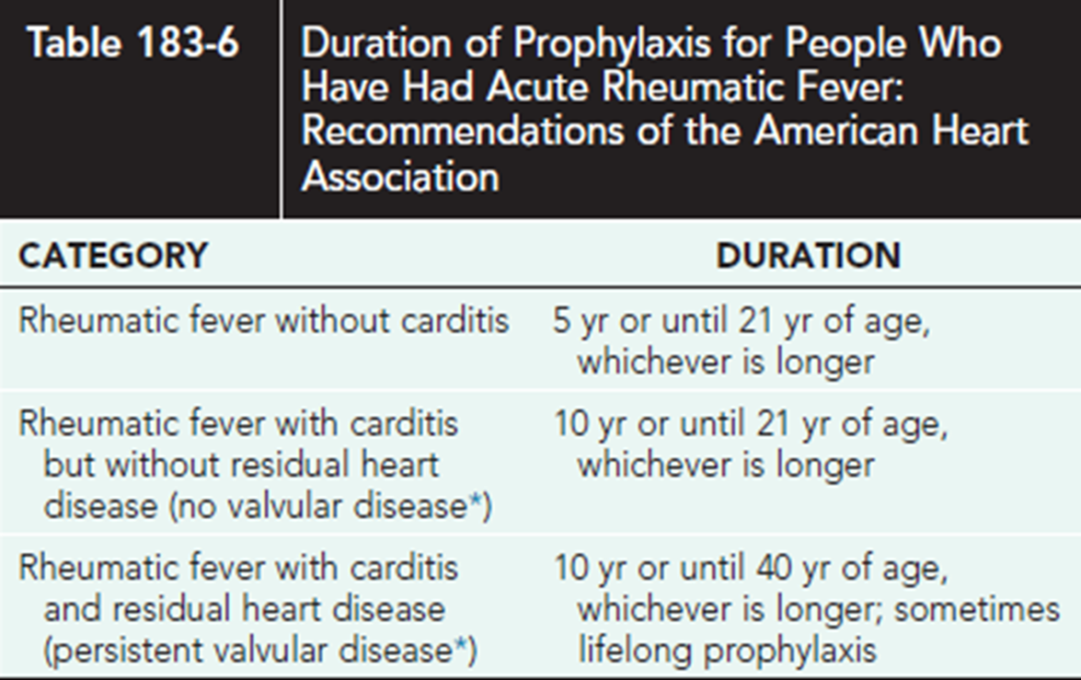
Cont’d
II. Secondary prevention (prevention of recurrence).
Benz. Penicillin 1.2M IU IM every 3 – 4 weeks.
Penicillin V 250mg po bid
Sulfadiazine 500 – 1000mg po/d
Erythromycin 250mg po BID

Slide 24
Infective endocarditis
Common: Native valve or other cardiac lesions
    Streptococcus Viridans
    Staphylococcus Aureus
    Group D Streptococcus
Prosthetic valve:
  Staphylococcus epidermidis
  Staphylococcus aureus
  Viridans group streptococcus
  Pseudomonas aeruginosa
Highest risk:
  prosthetic cardiac valves
  unrepaired cyanotic congenital heart disease
  completely repaired defects with prosthetic material or device during the 1st 6 mo after repair
  repaired congenital heart disease with residual defects at or adjacent to the site of a prosthetic patch
  previous infective endocarditis.

Slide 25
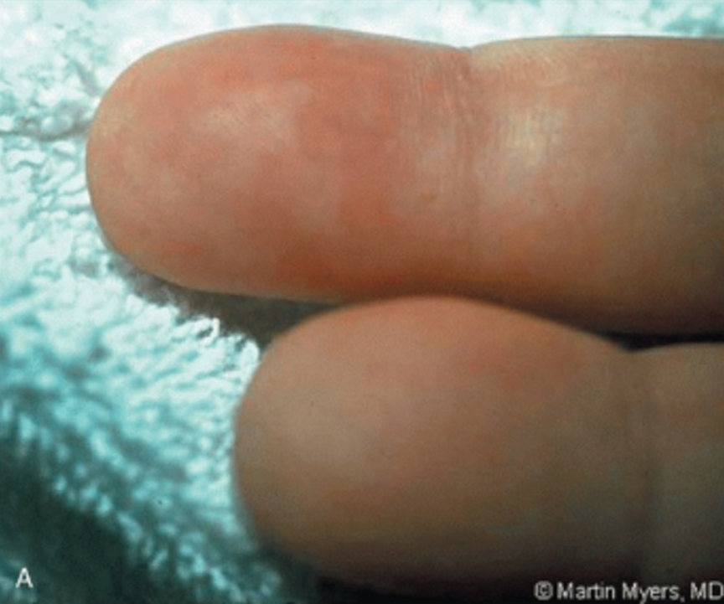
Cont’d
Osler’s node
  Tender pea sized intradermal nodule
  On the pad of fingers
  Due to immune depostion

Slide 26
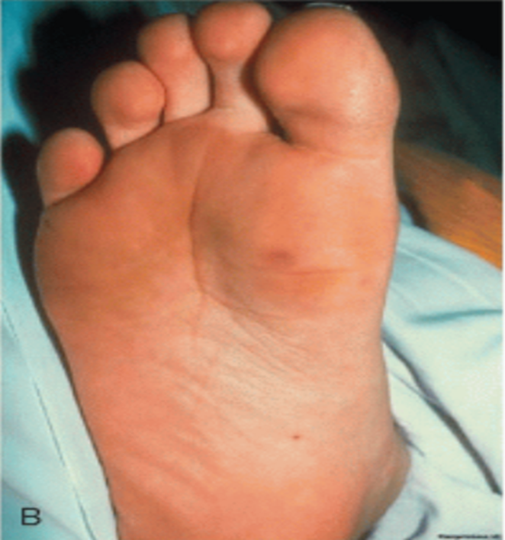
Cont’d
Janeway lession
  Painless small hemorrhagic lession on palms ans soles
  blaching

Slide 27
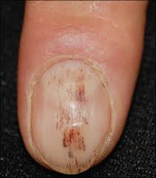
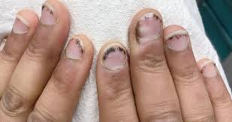
Cont’d
Splinter hemorrhage

Slide 28
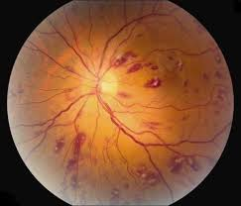
Cont’d
Rose spot
  White centered retinal hemorrhage

Slide 29
Duke criteria
  Major criteria
    positive blood cultures (2 separate cultures for a usual pathogen, 2 or more for less typical pathogens)
    2. evidence of endocarditis on echocardiography
      Intracardiac mass
      Regurgitant flow near a prosthesis
      Abscess
      Partial dehiscence of prosthetic valves
      New valve regurgitant flow
  Minor criteria
    predisposing conditions
    Fever
    embolic-vascular signs
    immune complex phenomena (glomerulonephritis, arthritis, rheumatoid factor, Osler nodes, Roth spots)
    Microbiologic
    a single positive blood cultur
    ECHO signs not meeting the major criteria.
    the presence of newly diagnosed clubbing, splenomegaly, splinter hemorrhages, and petechiae
    a high ESR and c-reactive protein
    and the presence of central nonfeeding lines, peripheral lines, and microscopic hematuria

Slide 30
Cont’d
Definite infective endocarditis:
A. Pathologic criteria:
  1. Microorganisms demonstrated by culture or histologic examination of a vegetation or
  2. Pathologic lesions; vegetation or intracardiac abscess confirmed by histologic examination showing active endocarditis
B. Clinical criteria:
  1. Two major criteria or
  2. One major criterion and three minor criteria; or
  3. Five minor criteria
POSSIBLE INFECTIVE ENDOCARDITIS:
  1. One major criterion and one minor criterion; or
  2. Three minor criteria
Rejected:
  1. Firm alternative diagnosis explaining evidence of IE; or
  2. Resolution of IE syndrome with antibiotic therapy for <4 days; or
  3. No pathologic evidence of IE at surgery or autopsy, with antibiotic therapy for <4 days; or
  4. Does not meet criteria for possible IE as above

Slide 31
Cont’d
Mx
Specific :
    Initial empiric antibiotics to cover Gram positive and negative organisms.
    Combination of cloxaxillin, ampicillin and gentamycin for 4-6 weeks (except gentamycin for 2 weeks)
If there is CHF:
    diuretics, afterload reducing agents, and in some cases, digitalis.
Surgery-intractable heart failure, mycotic aneurysm, dehiscence of intracardiac patch

Slide 32
Cont’d
Complications
  CHF is most common complication
  Systemic/pulmonary emboli
  Mycotic aneurysm
  Heart block
Prevention
  General dental care and oral hygiene
  Treatment of infection in high risk children
  Antibiotic prophylaxis before
      surgical procedures of respiratory tract systems

Slide 33
Pericardial disease (acute)
Infectious
  Viral : Coxsackie, Echo, EBV, Influenza, HIV
  Bacterial: TB, staph, hemophillus, pneumococcal, salmonella
  Fungal/other: histo/ blasto/ coccidio, rickettsia
Rheumatologic
  SLE, JRA, Sarcoid,, Dermatomyositis, Ankylosing Spondylitis, Scleroderma, PAN
Neoplastic
  Primary: angiosarcoma, mesothelioma
  Metastatic: breast, lung, lymphoma, melanoma, leukemia
Immunologic
  Celiac sprue, Inflammatory Bowel Disease
Drug
  Hydralizine, Procainamide
Other
  Post Pericardiotomy, Chest Trauma, Aortic dissection, MI, Uremic, Post Radiation
IDIOPATHIC -86%
types
Serous pericarditis
Fibrinous/ serofibrinous
  Most common type
  Bread and butter pericarditis
Purulent/ suppurative
Hemorrhagic pericarditis
Caseous pericarditis

Slide 34
Acute pericarditis
c/f
Often preceding viral illness 1-2wk prior
Chest Pain
  Sudden, sharp,pleuritic, constant, retrosternal
  worse supine/ L lat decub, relief in sitting up and leaning forward
  radiation: back, trapezius ridge
  symptoms usually resolve by 2 weeks, ECG abnormalities may persist for months
ECG
  PR depression
  ST elevation
Notes:
Friction rub (high pitched scratching noise)
Raised jugular venous pressure
Narrow pulse
tachycardia

Slide 35
Cont’d
Management
NSAIDS/ASA
  ASA 650 q3-4hr
  Ibuprofen 300-600 q 6-8 hrs x 1-4days
    Avoid Indocin, reduces CBF
Steroids
  if no response after 48hr NSAID
  use concurrent NSAID
Colchicine
  chronic +/- NSAID
  useful in recurrent pericarditis
  symptom free period 3.1 +/- 3mos vs 43 +/- 35mos (p<.00001)
  in largest multicenter trial to date
Complications
  Pericardial Effusion/ Tamponade
  Constrictive Pericarditis
    can be “transient” – 10% may have transient sxs within 1st month, resolves by 3 months
  Recurrent Pericarditis (20-25%)
    Rx – NSAIDS/ Colchicine +/- steroids

Slide 36
Constrictive pericarditis
Cause
  Cardiac surgery
  Radiotherapy
  TB
  Collagen vascualr disease
  Post viral pericarditis
  Infiltration by neopasms
MX
  The only effective treatment for chronic constrictive pericarditis is complete surgical resection of the pericardium.

Slide 37
restrictive
constrictive
HX: storage and infiltrative diseases
PE: may be kussmaul sign
  Prominent apical impulse
  S3 rarely S4
  Regargitant Murmur is common
ECG: Left axis deviation
  Atrial fib.
Echo: Increased wall thickess
  Thickned valves
CT/MRI: Pericardium usually normal
  <2mm
Endomyocardial bx: reveal specific disease
HX: TB, trauma…
PE: Kussmaul sign usually+ve
  Apical impulse not palpable
  Pericardial knock
  Regargitatn murmur uncommon
ECG: Square root or Dip palateu sign
Echo: normal wall thickness
  Pericardial thickening may b
CT/ MRI
  Pericaardium may be thickend >4mm
Endomyocardial bx: may be normal
Notes:
Kussmaul’s sign: decrease in JVP with inspiration

Slide 38
Cardiac tamponade
Constrictive
Low cardiac output state
NO Kussmaul’s sign
RA: blunted y descent
Decreased heart sounds
Pulsus Paradoxus
Echo effusion
Low cardiac output state
Kussmaul’s sign
RA: rapid y descent
Pericardial “knock”
No pulsus paradoxus
Echo thick pericardium

Slide 39
Cardiac Tamponade
Important associated symptoms:
  Dyspnea
  Chest Pain
  Feeling of “Fullness”
  Nausea/Abdominal pain (from hepatic/visceral congestion)
  Dysphagia (from esophageal compression)
Nonspecific Sxs:
  Lethargy, fever, cough, weakness, fatigue, anorexia, palpitations
Classically tachycardic, hypotensive and tachypenic
  BUT pts with pre-existing HTN may still be hypertensive with tamponade!
Diminished heart sounds
Kussmaul sign: inspiratory elevation of JVP
  Present only in underlying constrictive disease
Possible friction rub

Slide 40
Cont’d
Classic “Beck’s Triad”
  Decreased arterial BP
  Increased JVP
  Quiet heart sounds
Pulsus Paradoxus
  exaggeration of the normal inspiratory decrease in BP (ie, it is present normally)
  “Abnormal” pulsus paradoxus = >10mmHg difference
  A pulsus paradoxus >20 mm Hg in a child with pericarditis is an indicator of the presence of cardiac tamponade
  a 10–20 mm Hg change is equivocal.

Slide 41
Cont’d
Ddx (pulsus paradox)
  Severe COPD
  CHF
  Mitral Stenosis
  Massive PE
  Severe hypovolemic shock
  Obesity
  Tense ascites
Conditions that can mask wide pulsus paradoxus:
  Hypotension
  Pericardial adhesions
  Aortic regurg
  ASD
  RVH

Slide 42
DX
1. Cardiac Catheterization
2. Chest Radiography:
3. Electrocardiogram:
  Electrical alternans
  Every other QRS is of smaller voltage
  Atrial arrhythmias
4. ECHO:
  Circumferential fluid layer
  Specific sign is chamber collapse:

Slide 43
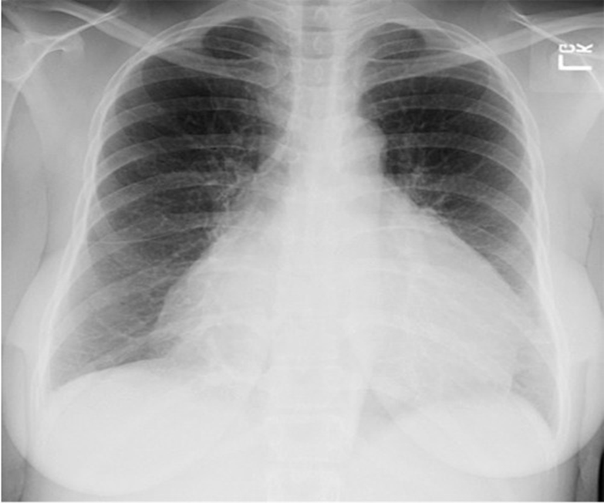
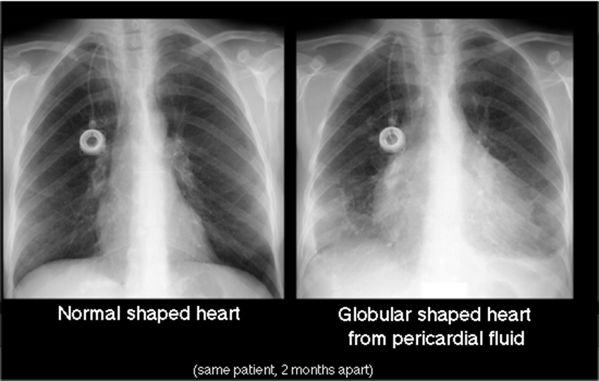
Cont’d
CXR
Depends on the size of the effusion
  Enlarged, globular heart (“water bottle”) or flask shaped
  Epicardial fat stripe
  Can be normal

Slide 44
Cont’d
MX
Pericardiocentesis:
Blindly in the case of an emergency
With ECHO, fluoroscopy or CT guidance
2. Pericardiotomy:
If the heart cannot be reached by a needle/catheter.
Indicated in patients with intrapericardial bleeding, clotted hemopericardium.
3. Positive airway pressure should be avoided as it decreases cardiac output

Slide 45
Pericardial Effusions
Secondary to many processes (viral, Tb, malignancies, uremia)
TYPES :
Transudative (CHF, Myxoedema, Nephrotic Syndrome),
Exudative (tuberculosis, spread from empyema)
Haemorrhagic (trauma, rupture of aneuryms, malignant effusion).

Slide 46
CHF (mx prnciple)
1. supportive
  Bed rest, frequent positioning, DVT prophylaxis
  salt restriction
  Water restriction
  Oxygen
  Nutrition
  Daily weight
2. RX of the failed heart
  Overload reducers
    ACE I
    B blockers
    Spironolactone
  Preload reducers
    diuretics
  Increase myocardial contractylity
    Digoxin
    Dopamin
    doubutamin

Slide 47
Cont’d
3. RX of the underlying condition
  Cardiac surgery
  Correct rhythm abnormality
  Transfuse if anemia
  Anti hypertensive
  Correct met. abnormality
4. Rx of the precipitating factors
  Hypertension
  Endocarditis
  Arrythmia
  Rheumatic fever
  Thyrotoxicosis
  Fever
  Arrythmia
  Infection
  Liver
  Salt/ stress

